Slide 2




Plan
Regularization
- Ridge
- Lasso
- ElasticNet
Models
- KNN
- Decision Tree
- SVM
Ensembles
- Bagging
- Boosting
Duration : ~15 min
Duration : ~30 min
Duration : ~30 min
Hyperparameter Opt.
- Grid
- Random
Duration : ~10 min

Slide 3
Introduction

Slide 4

Quiz: First session
1. What the objective of Machine Learning (supervised Learning)?
2. How do we evaluate a model?
3. What models did we see in first session? What their limits?
Raphael Cousin — Sorbonne University

Slide 5


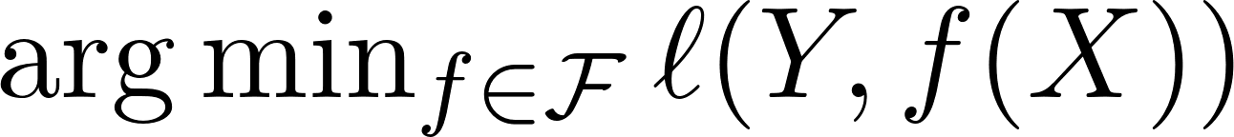
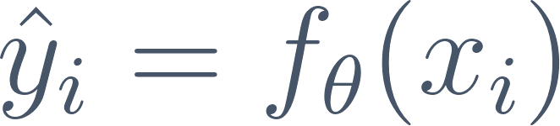


ML Objective
Dataset
Models
Optimization
Pair of X variable, Y target
A model maps p input features to a prediction.
Find the model that minimizes the loss.
The goal: make as close to as possible.
Raphael Cousin — Sorbonne University

Slide 6
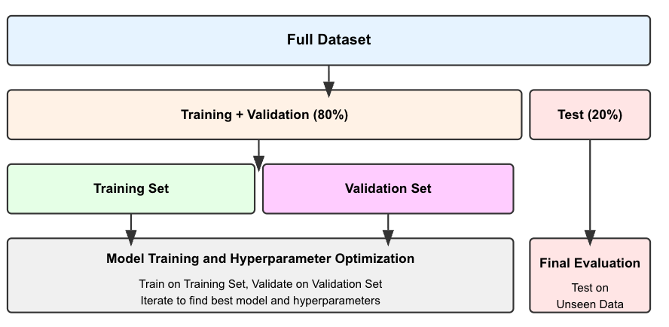
Model Evaluation Train/Test Split
Raphael Cousin — Sorbonne University

Slide 7
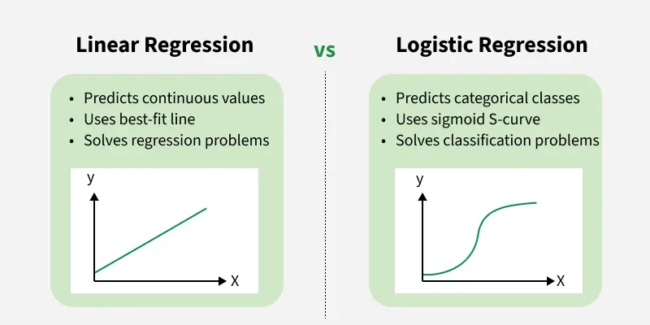
Linear Regression
Raphael Cousin — Sorbonne University

Slide 8
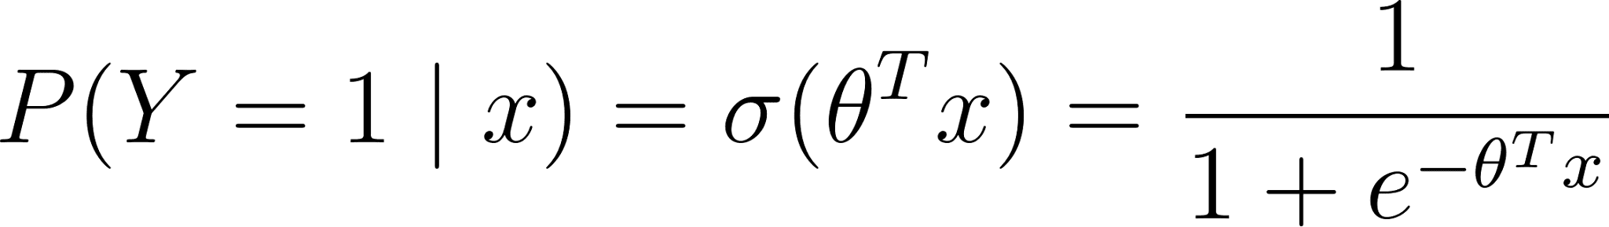
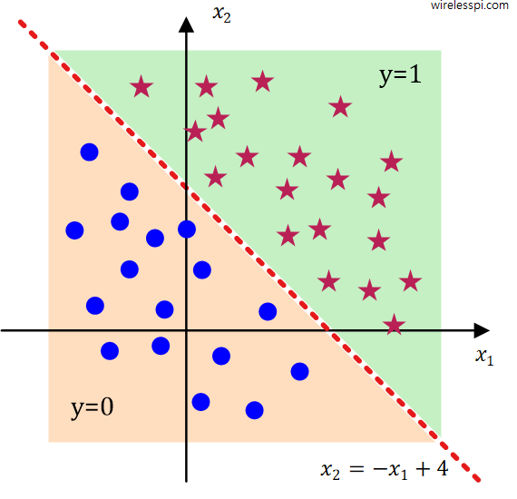
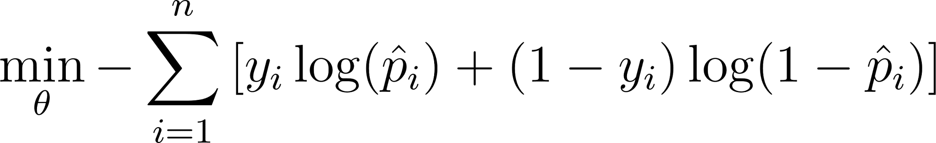

Logistic Regression
Raphael Cousin — Sorbonne University

Slide 9
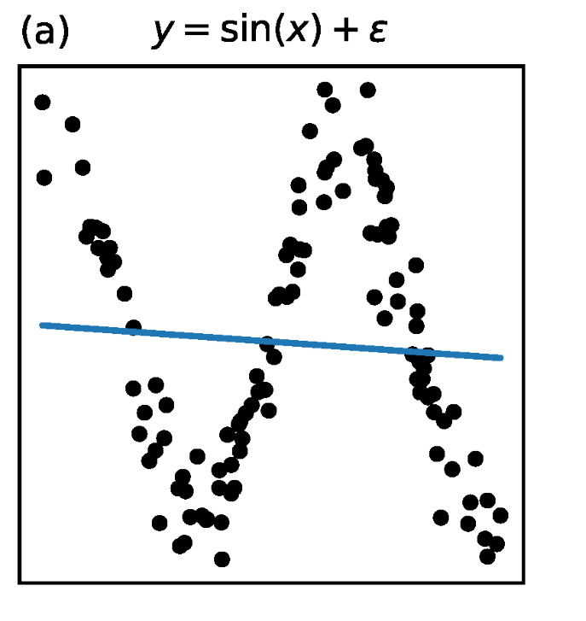
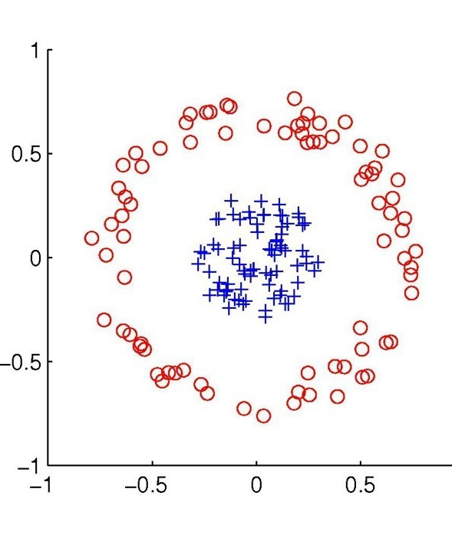
Non linear data
Linear Regression and logistic regression will not cover those cases
Raphael Cousin — Sorbonne University

Slide 10
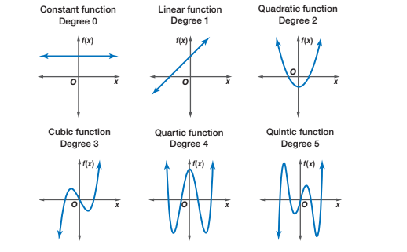
Polynomial regression
Same linear regression, new features. Non-linear in X, linear in theta
Raphael Cousin — Sorbonne University

Slide 11
Regularization in scikit-learn
from sklearn.preprocessing import PolynomialFeatures
from sklearn.linear_model import LinearRegression
from sklearn.pipeline import Pipeline
model = Pipeline([
('poly', PolynomialFeatures(degree=3)),
('reg', LinearRegression())
])
model.fit(X_train, y_train)
y_pred = model.predict(X_test)
Note: alpha in sklearn = lambda in formulas
Raphael Cousin — Sorbonne University

Slide 12
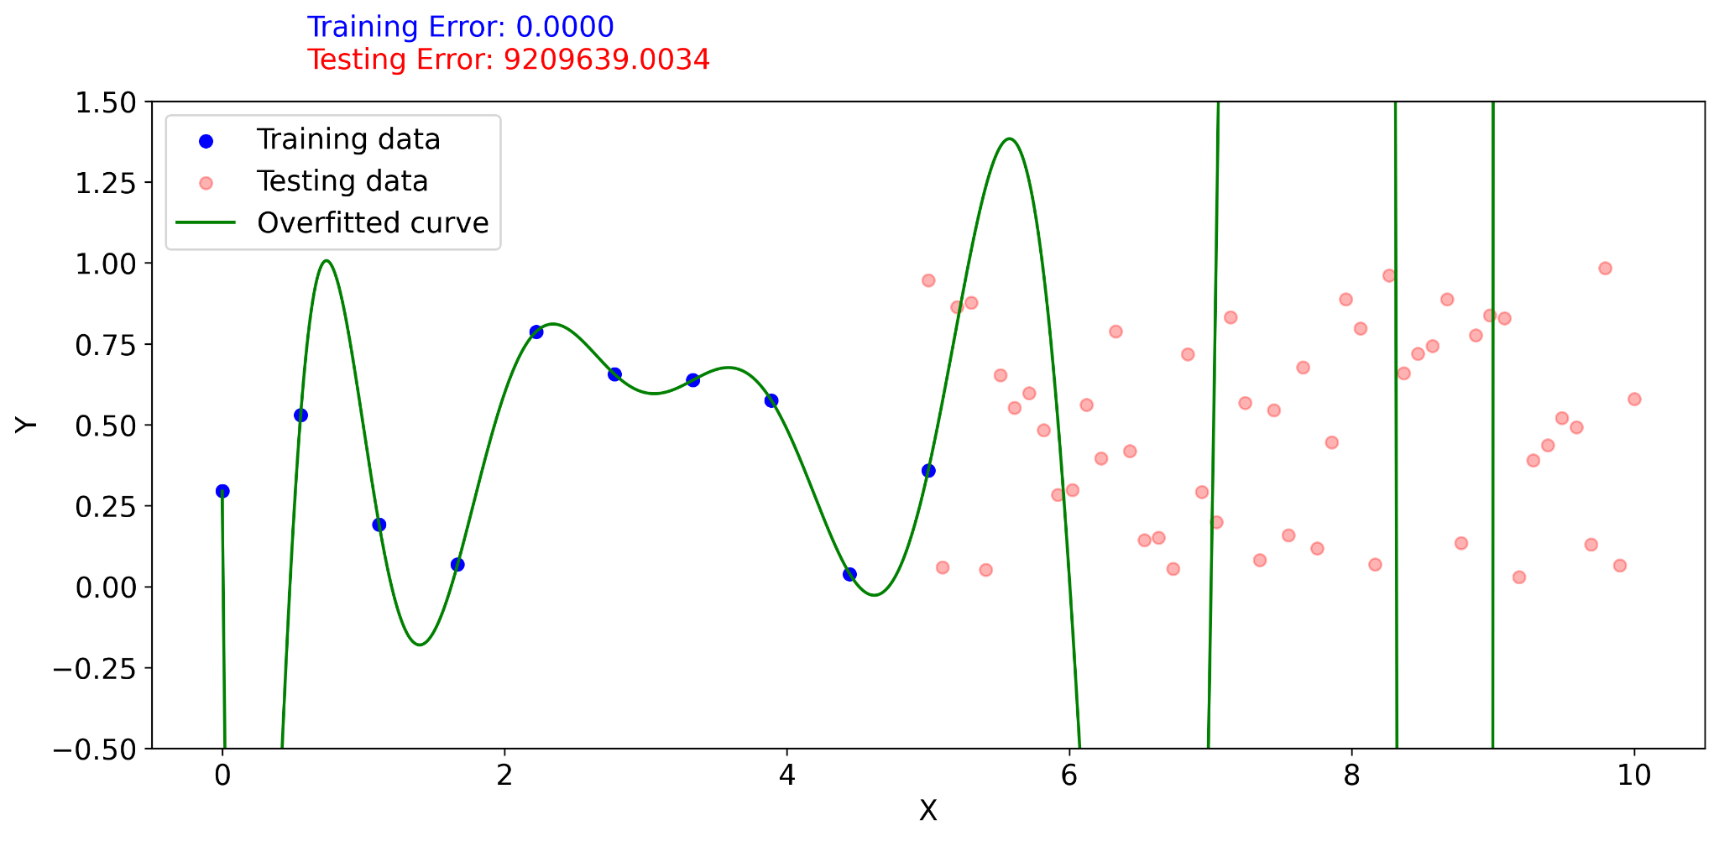
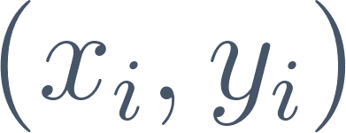
Overfitting
Theorem: For n data points with
A polynomial of degree d=n−1 fits all points exactly.
Raphael Cousin — Sorbonne University

Slide 13
Regularization

Slide 14
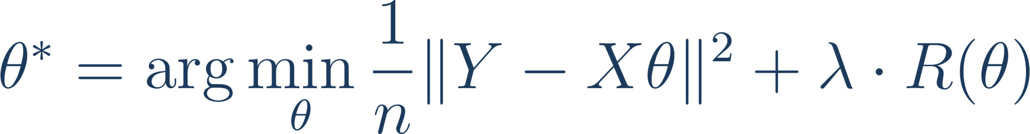
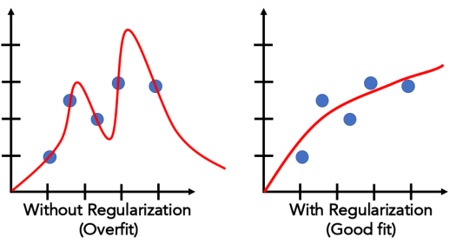



The Regularization Idea
Penalizing large parameters forces the model to find simpler solutions that generalize better.:
controls strength of regularization (hyperparameter)
: no penalty → standard loss
: all coefficients → 0
Raphael Cousin — Sorbonne University

Slide 15
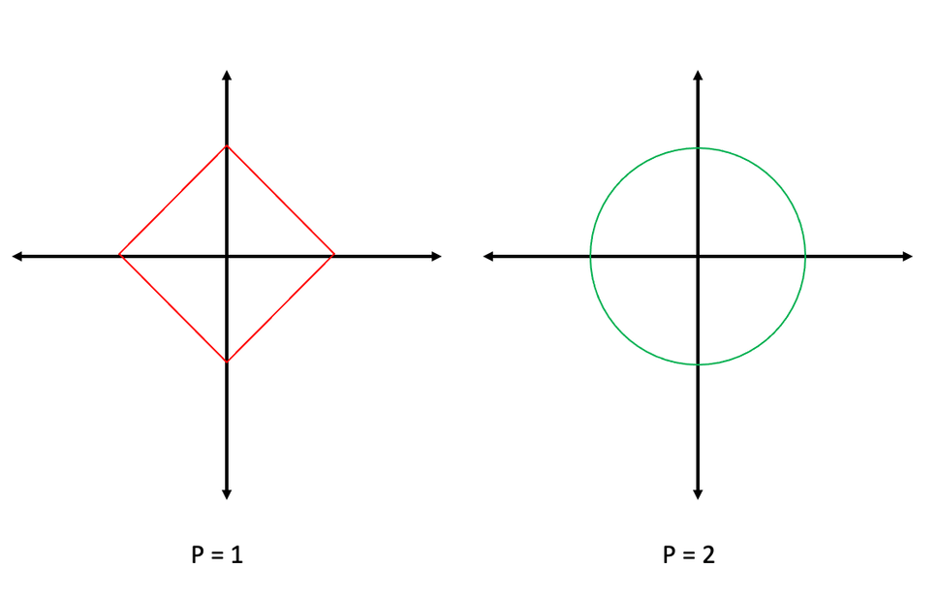
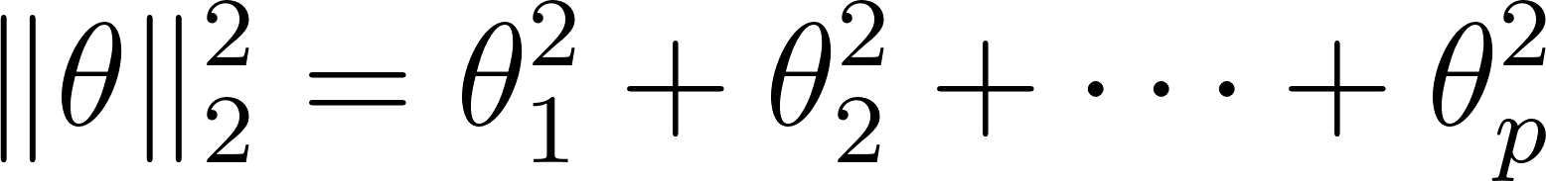
Karush-Kuhn-Tucker - condition
Raphael Cousin — Sorbonne University

Slide 16
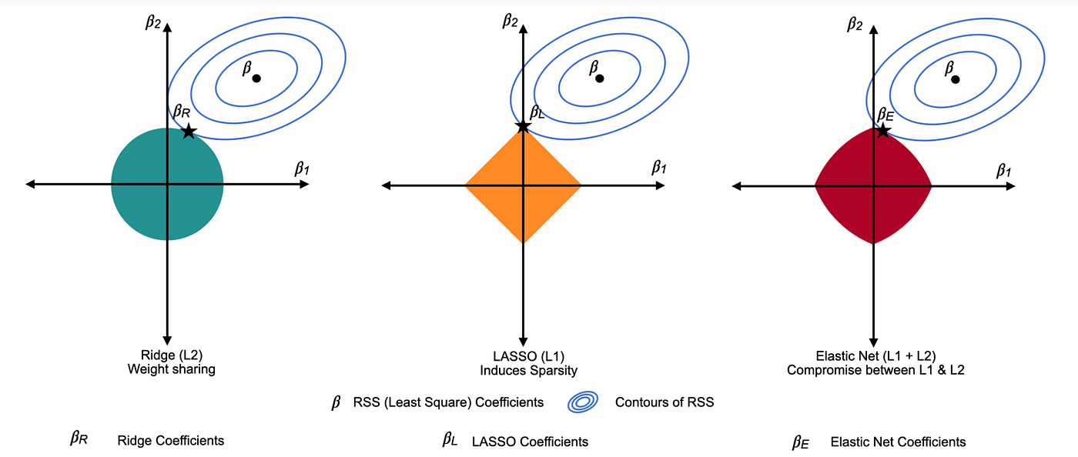
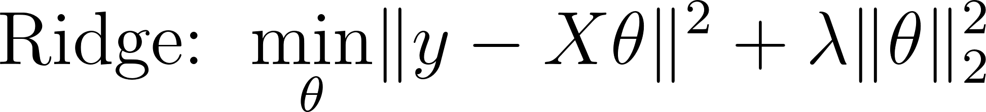
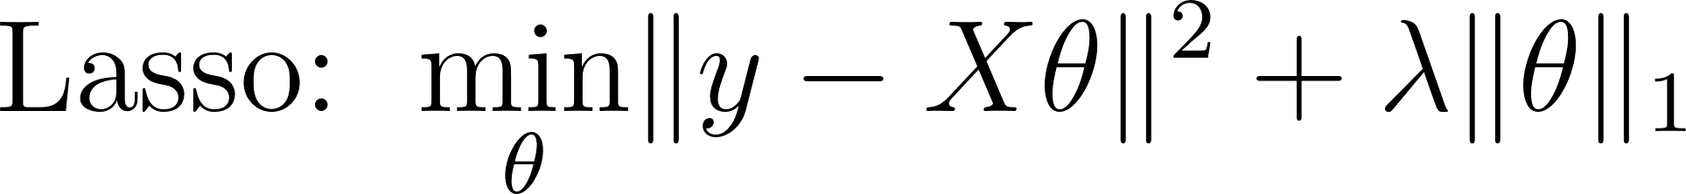
Ridge / Lasso / Elastic Net
Raphael Cousin — Sorbonne University

Slide 17
Regularization in scikit-learn
from sklearn.linear_model import Ridge, Lasso, ElasticNet
ridge = Ridge(alpha=1.0)
lasso = Lasso(alpha=0.1)
elastic = ElasticNet(alpha=0.1, l1_ratio=0.5)
model.fit(X_train, y_train)
y_pred = model.predict(X_test)
Note: alpha in sklearn = lambda in formulas
Raphael Cousin — Sorbonne University

Slide 18
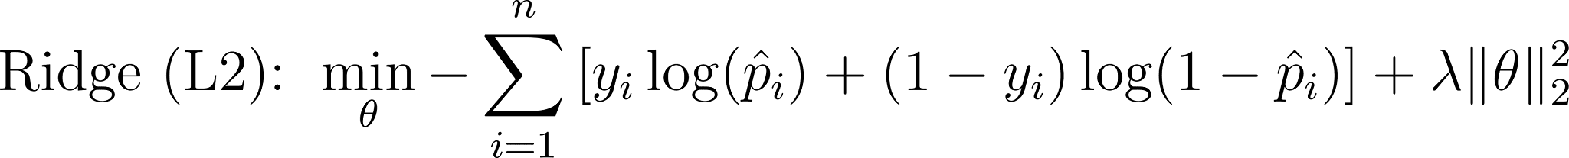
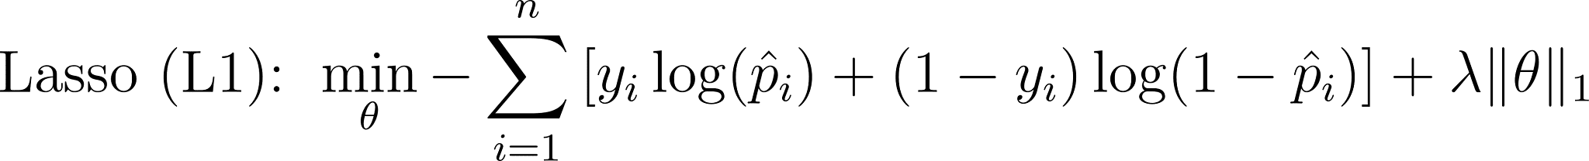
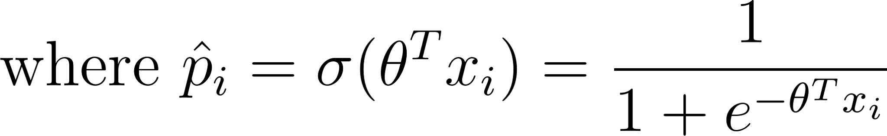
Regularization for classification
Raphael Cousin — Sorbonne University

Slide 19
Regularization classification.
from sklearn.linear_model import LogisticRegression
ridge = LogisticRegression(penalty='l2', C=1.0)
lasso = LogisticRegression(penalty='l1', C=10, solver='saga')
elastic = LogisticRegression(penalty='elasticnet', C=10, l1_ratio=0.5, solver='saga')
model.fit(X_train, y_train)
y_pred = model.predict(X_test)
Note: In sklearn, C = 1/λ
Raphael Cousin — Sorbonne University

Slide 20
QUIZ : Regularization
Why we apply regularization?
Which regularization method performs feature selection?
Raphael Cousin — Sorbonne University

Slide 21
K-Nearest Neighbors

Slide 22
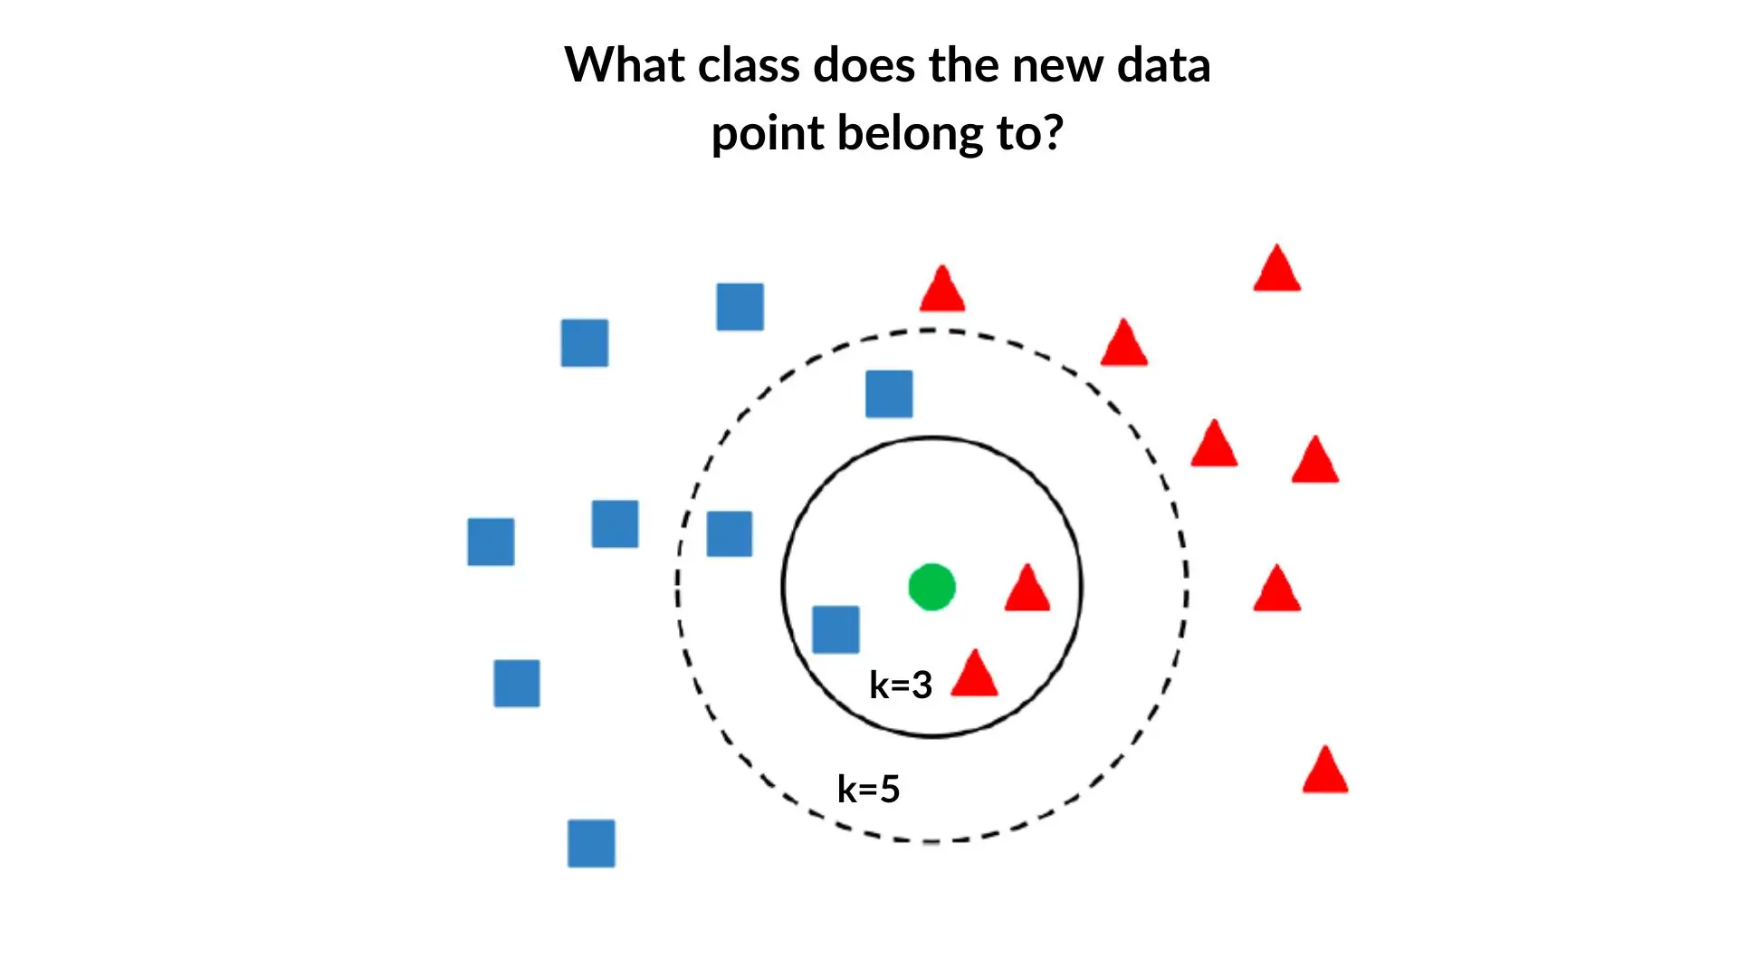
KNN: The Idea
Non-parametric, instance-based (memory-based)
No training phase — just store the data
Prediction: look at the K closest neighbors, vote / average
Raphael Cousin — Sorbonne University

Slide 23
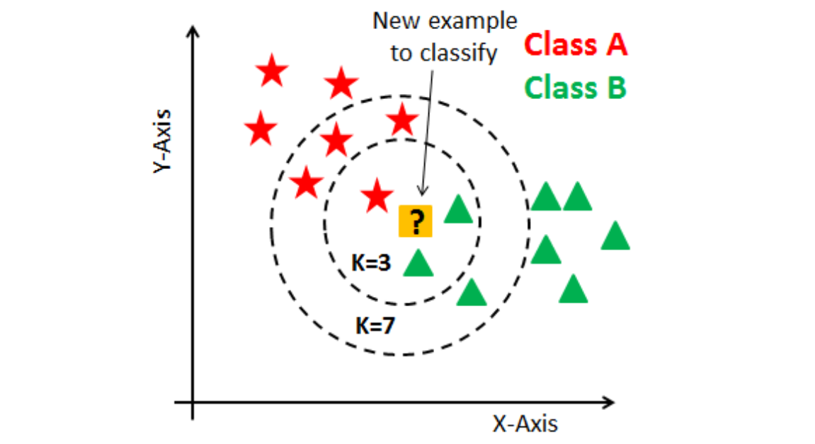
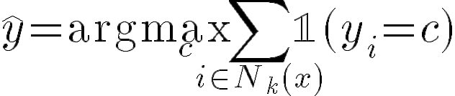
KNN Classification
For a new point x: find K nearest neighbors
Predict majority class:
Raphael Cousin — Sorbonne University

Slide 24
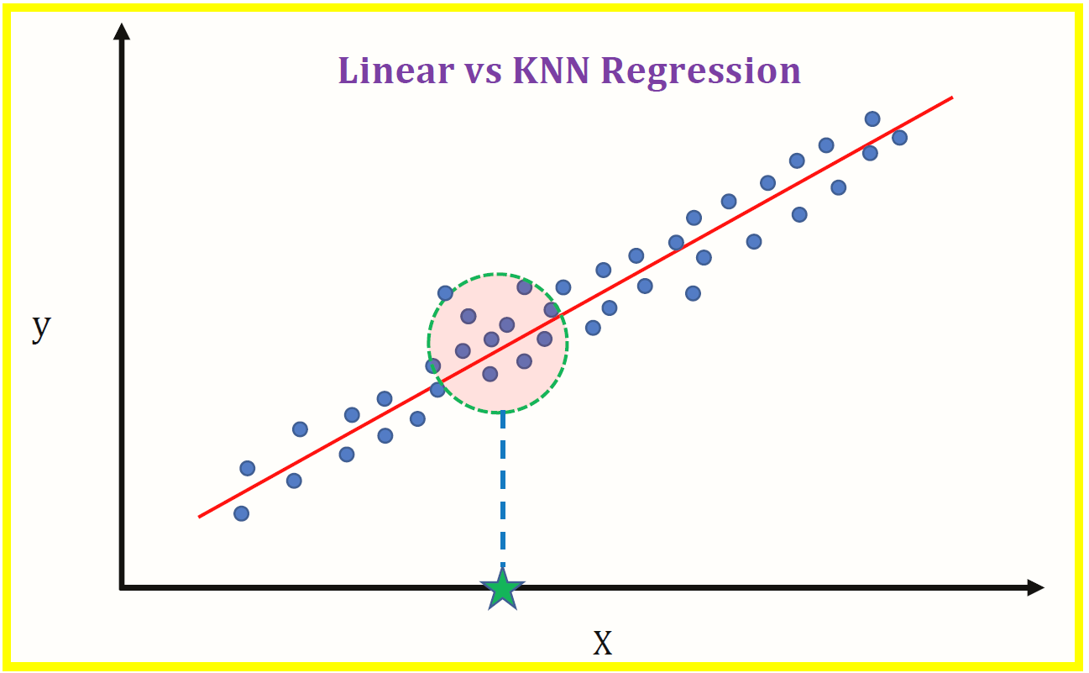
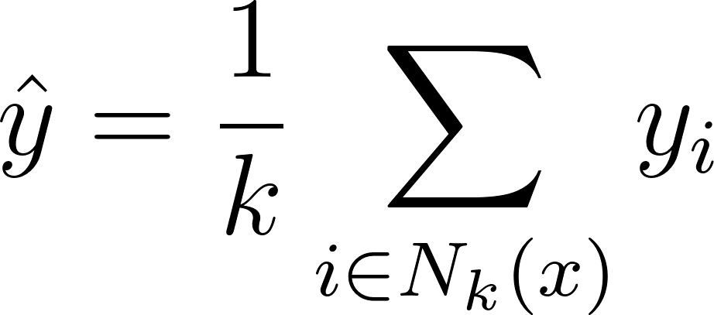
KNN Regression
Same idea but average the target values:
Raphael Cousin — Sorbonne University

Slide 25
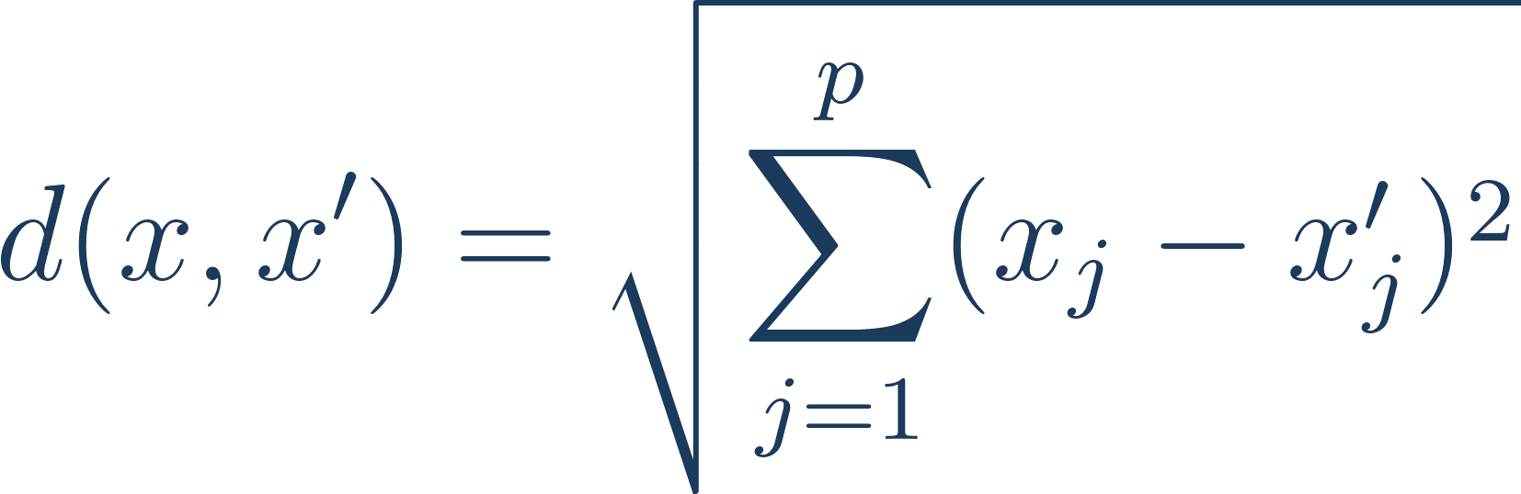
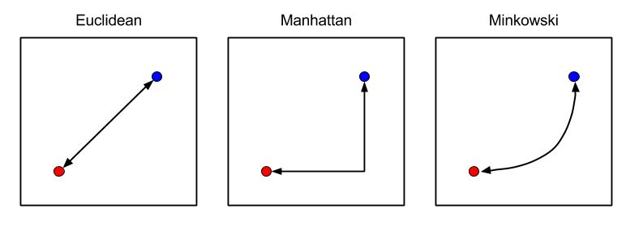
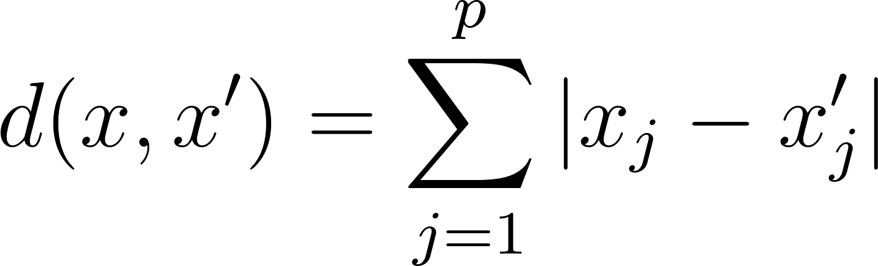
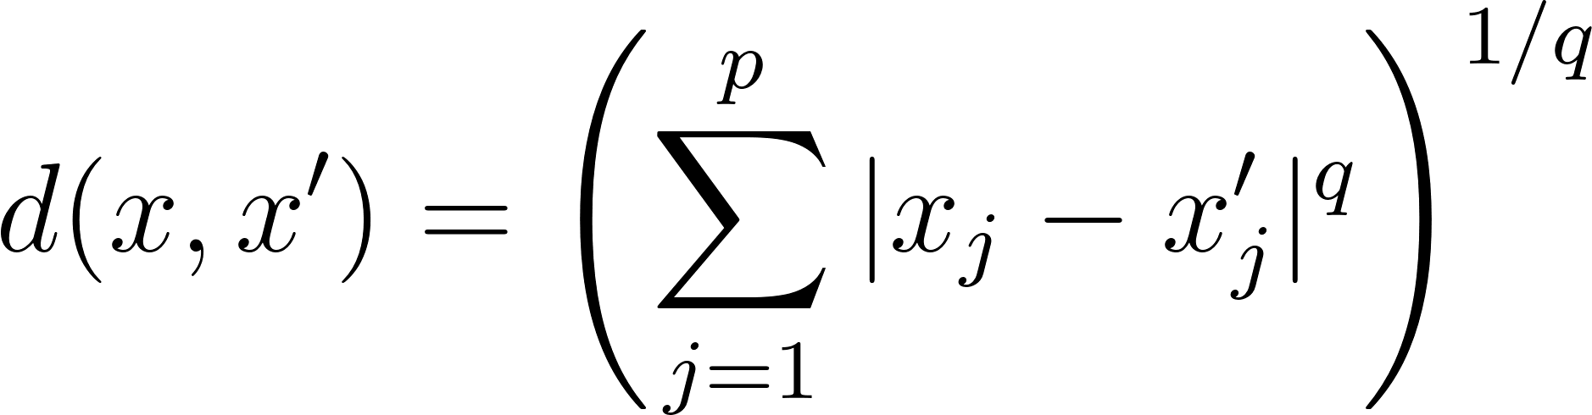
Distance Metrics
Euclidean:
Manhattan:
Minkowski:
Important: Features must be scaled! (StandardScaler)
Raphael Cousin — Sorbonne University

Slide 26
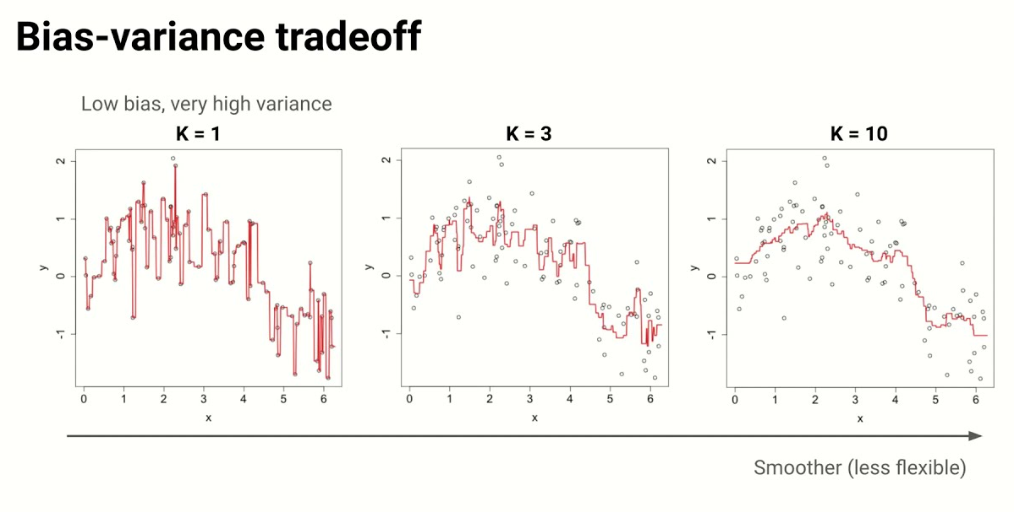
The Key Hyperparameter
K small (e.g. 1): complex boundary, overfitting — low bias / high variance
K large (e.g. n): smooth boundary, underfitting — high bias / low variance
Raphael Cousin — Sorbonne University

Slide 27
KNN in scikit-learn
from sklearn.neighbors import KNeighborsClassifier
from sklearn.preprocessing import StandardScaler
scaler = StandardScaler()
X_train_s = scaler.fit_transform(X_train)
X_test_s = scaler.transform(X_test)
knn = KNeighborsClassifier(n_neighbors=5)
knn.fit(X_train_s, y_train)
y_pred = knn.predict(X_test_s)
Raphael Cousin — Sorbonne University

Slide 28
KNN in scikit-learn
from sklearn.neighbors import KNeighborsRegressor
from sklearn.preprocessing import StandardScaler
scaler = StandardScaler()
X_train_s = scaler.fit_transform(X_train)
X_test_s = scaler.transform(X_test)
knn = KNeighborsRegressor(n_neighbors=5)
knn.fit(X_train_s, y_train)
y_pred = knn.predict(X_test_s)
Raphael Cousin — Sorbonne University

Slide 29
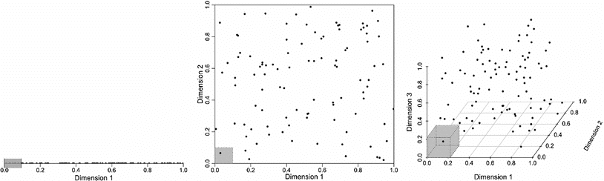
Curse of dimension
As dimensions increase, data becomes exponentially sparse. KNN neighbors become far and meaningless.
Raphael Cousin — Sorbonne University

Slide 30
KNN: Pros & Cons
Pros
Cons
Simple and intuitive
No training phase
Works for any number of classes
Non-linear decision boundaries
Slow at prediction: O(n·p) per query
Curse of dimensionality
Requires feature scaling
Raphael Cousin — Sorbonne University

Slide 31
Decision Trees

Slide 32
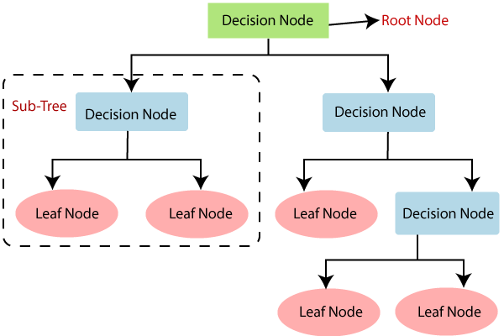
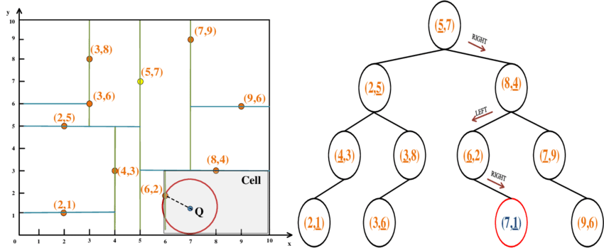
Decision Tree: The Idea
Recursive binary partitioning of feature space
Each internal node = a question on a feature (e.g. "Is x₁ > 3.5?")
Each leaf = a prediction (class label or value)
Goal: find feature j and threshold t that best separates label (classes/values)
Raphael Cousin — Sorbonne University

Slide 33
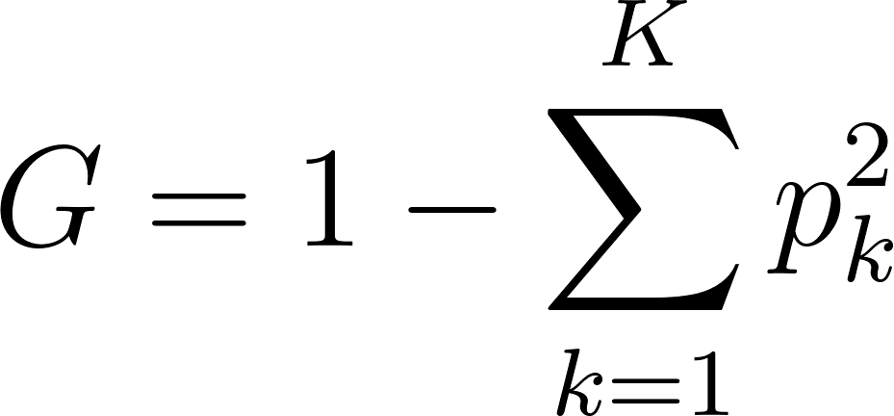
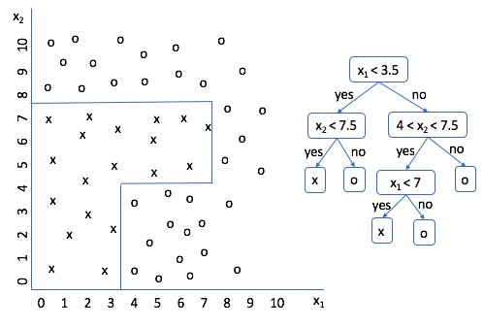
Classification
Minimize Gini impurity within each child node
Gini Impurity:
G = 0 → pure node (all same class)
G = 0.5 → maximum impurity (binary case)
Leaf prediction = majority class in leaf
Raphael Cousin — Sorbonne University

Slide 34
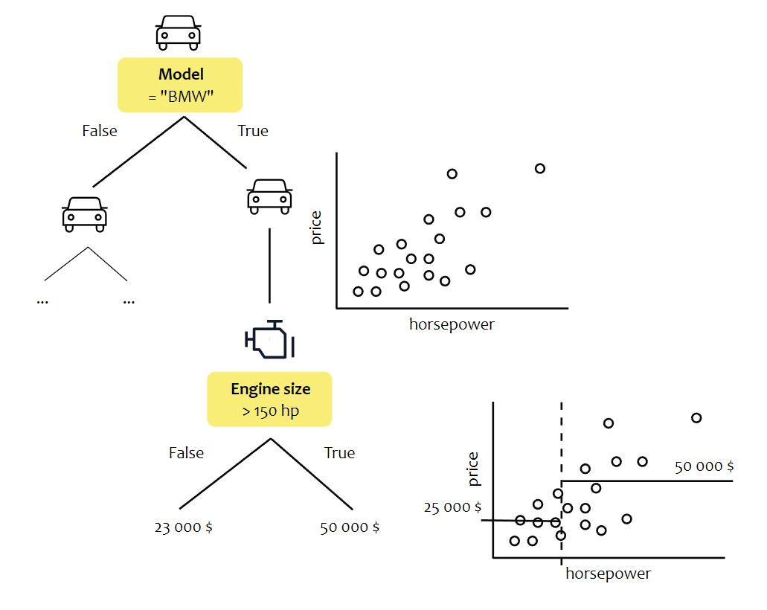
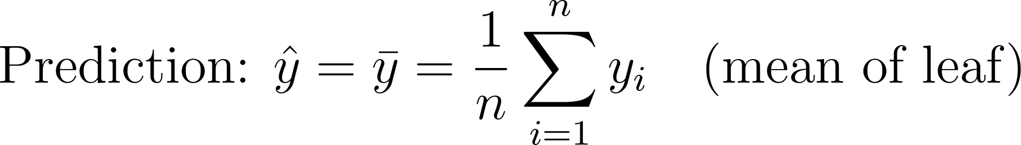
How to Split? — Regression
Minimize MSE within each child node
Leaf prediction = mean of target values in the leaf
Raphael Cousin — Sorbonne University

Slide 35
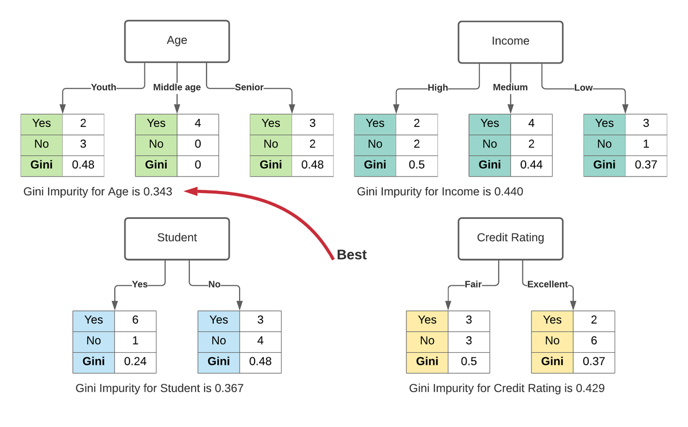
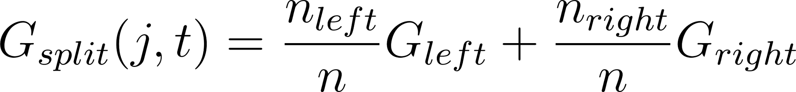
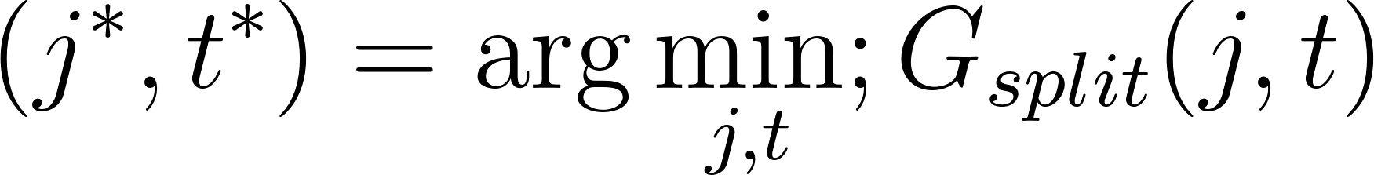
Split algorithm
For each node, test all possible splits (j, t)
Raphael Cousin — Sorbonne University

Slide 36
Example
Student | Hours studied | Sleep | Result
1 | 2 | 8 | Fail
2 | 3 | 6 | Fail
3 | 5 | 7 | Pass
4 | 6 | 5 | Pass
5 | 7 | 8 | Pass
6 | 8 | 4 | Pass
Raphael Cousin — Sorbonne University

Slide 37
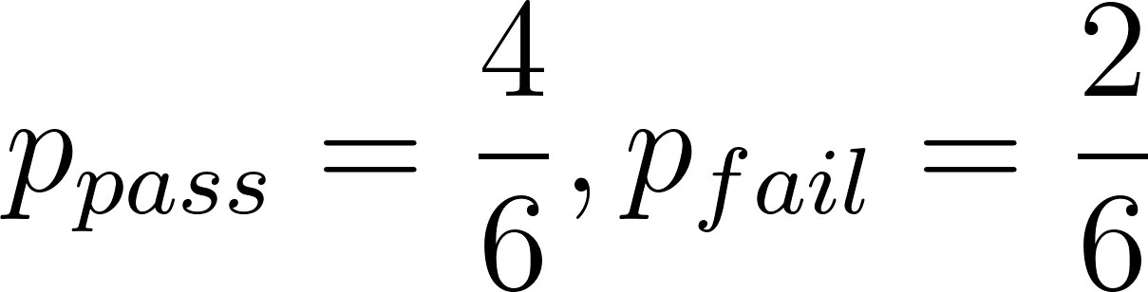
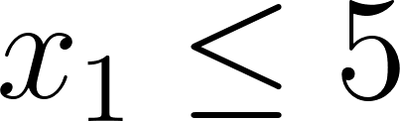
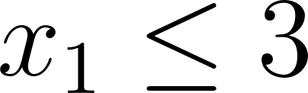
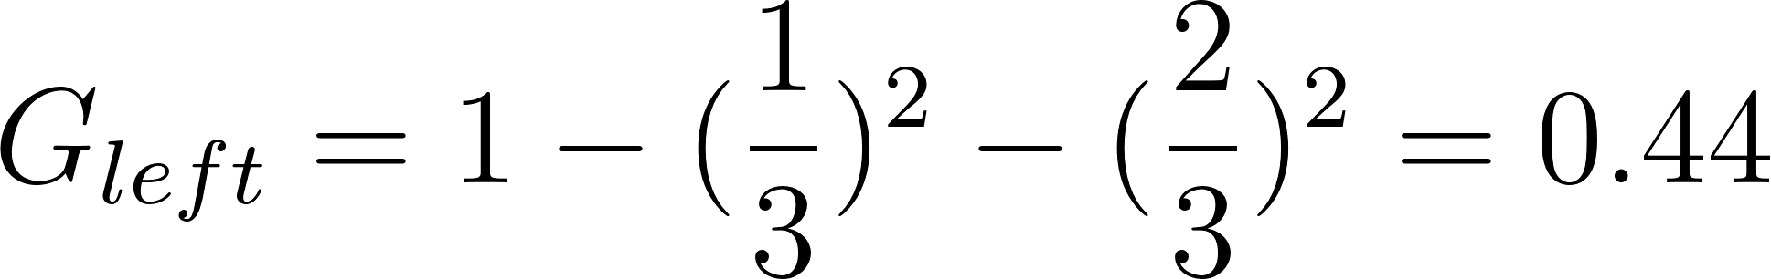
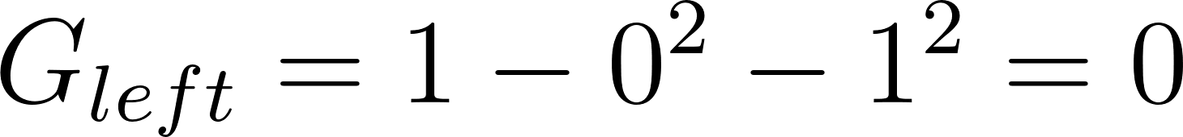
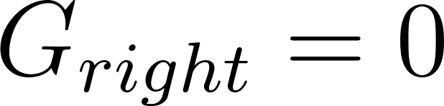
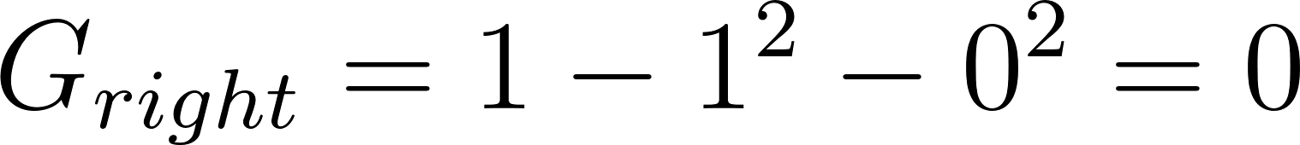
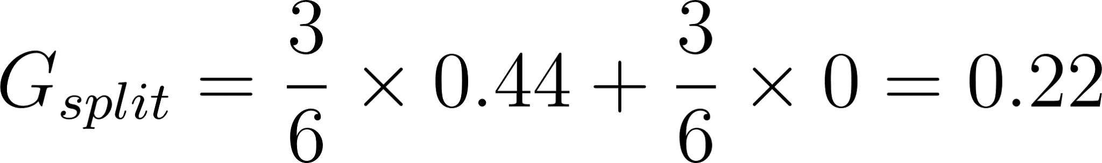

Example
4 Pass, 2 Fail →
Test split:
Left (students 1,2,3): 1 Pass, 2 Fail →
Right (students 4,5,6): 3 Pass, 0 Fail →
Test split:
Left (students 1,2): 0 Pass, 2 Fail → (pure!)
Right (students 3,4,5,6): 4 Pass, 0 Fail → (pure!)
Conclusion:
gives lower inpurty → algorithm picks this split.
In practice it tests ALL thresholds for ALL features and keeps the best.
Raphael Cousin — Sorbonne University

Slide 38
Controlling Tree Complexity
Trees grow until pure leaves → overfitting!
Hyperparameters to control depth:
Parameter | Effect
max_depth | Maximum tree depth
min_samples_split | Min samples required to split a node
min_samples_leaf | Min samples required in a leaf
max_features | Number of features considered per split
Raphael Cousin — Sorbonne University

Slide 39
Decision Tree in scikit-learn
from sklearn.tree import DecisionTreeClassifier, plot_tree
tree = DecisionTreeClassifier(max_depth=4)
tree.fit(X_train, y_train)
y_pred = tree.predict(X_test)
# Visualization
plot_tree(tree, filled=True)
Raphael Cousin — Sorbonne University

Slide 40
Decision Tree in scikit-learn
from sklearn.tree import DecisionTreeRegressor, plot_tree
tree = DecisionTreeRegressor(max_depth=4)
tree.fit(X_train, y_train)
y_pred = tree.predict(X_test)
# Visualization
plot_tree(tree, filled=True)
Raphael Cousin — Sorbonne University

Slide 41
Decision Trees: Pros & Cons
Pros
Cons
Interpretable (white-box model)
No feature scaling needed
Handles mixed feature types
Fast training and prediction
High variance (unstable)
Axis-aligned splits only
Overfits easily without pruning
Weak alone — powerful in ensembles!
Raphael Cousin — Sorbonne University
3 observations / 6 variables
9 observations / 3 variables

Slide 42
QUIZ : KNN & Trees
1. You have 1000 features. Would KNN work well? Why?
2. What happens to a decision tree if you set max_depth=None?
3. For KNN, you forgot to scale. Feature A ∈ [0,1], Feature B ∈ [0,10000]. What happens?
Raphael Cousin — Sorbonne University

Slide 43
Support Vector Machines

Slide 44

SVM: The Idea
Find the hyperplane that maximizes the margin between classes
Margin = distance between hyperplane and nearest data points
Nearest points = support vectors (they define the boundary)
Raphael Cousin — Sorbonne University

Slide 45






Linear SVM: Math
Hyperplane:
Decision:
Margin =
Objective:
Find the hyperplane that maximizes the marge
Raphael Cousin — Sorbonne University

Slide 46





Linear SVM: Math
Raphael Cousin — Sorbonne University

Slide 47


Soft Margin SVM
Real data is not perfectly separable
C = hyperparameter: margin vs misclassification tradeoff
Small C → wide margin, more errors allowed
Large C → narrow margin, fewer errors tolerated
Raphael Cousin — Sorbonne University

Slide 48





The Kernel Trick
Instead of computing explicitly, use kernel:
Kernel | Formula
Linear
Polynomial
RBF (Gaussian)
Raphael Cousin — Sorbonne University

Slide 49
SVM in scikit-learn
from sklearn.svm import SVR
from sklearn.preprocessing import StandardScaler
scaler = StandardScaler()
X_train_s = scaler.fit_transform(X_train)
X_test_s = scaler.transform(X_test)
svr_linear = SVR(kernel='linear', C=1.0)
svr_rbf = SVR(kernel='rbf', C=1.0, gamma='scale')
svr_rbf.fit(X_train_s, y_train)
y_pred = svr_rbf.predict(X_test_s)
Note: SVM needs scaled features (like KNN)
Raphael Cousin — Sorbonne University

Slide 50
SVM in scikit-learn
from sklearn.svm import SVC
from sklearn.preprocessing import StandardScaler
scaler = StandardScaler()
X_train_s = scaler.fit_transform(X_train)
X_test_s = scaler.transform(X_test)
svm_linear = SVC(kernel='linear', C=1.0)
svm_rbf = SVC(kernel='rbf', C=1.0, gamma='scale')
svm_rbf.fit(X_train_s, y_train)
y_pred = svm_rbf.predict(X_test_s)
Note: SVM needs scaled features (like KNN)
Raphael Cousin — Sorbonne University

Slide 51
SVM: Pros & Cons
Pros
Cons
Effective in high dimensions
Memory-efficient (only support vectors)
Flexible via kernel choice
Slow for large datasets: O(n²) to O(n³)
Sensitive to feature scaling
No native probability output
Raphael Cousin — Sorbonne University

Slide 52
Models Summary
Model | Type | Parametric? | Scaling? | Key Hyperparams
Linear/Ridge/Lasso | Reg/Clf | Yes | Recommended | lambda
KNN | Reg/Clf | No | Required | K
Decision Tree | Reg/Clf | No | Not needed | max_depth
SVM | Clf (Reg) | Yes | Required | C, kernel
Raphael Cousin — Sorbonne University

Slide 53
Ensemble Methods: Bagging

Slide 54


Why Ensembles?
Single models have weaknesses (bias or variance)
Idea: combine multiple models for better performance
"Wisdom of the crowd" — aggregate diverse opinions
Raphael Cousin — Sorbonne University

Slide 55
Voting SVM in scikit-learn / classification
from sklearn.ensemble import VotingClassifier
from sklearn.svm import SVC
from sklearn.tree import DecisionTreeClassifier
from sklearn.neighbors import KNeighborsClassifier
model = VotingClassifier(estimators=[
('svm', SVC(kernel='rbf', C=1.0)),
('tree', DecisionTreeClassifier(max_depth=4)),
('knn', KNeighborsClassifier(n_neighbors=5))
], voting='hard')
model.fit(X_train, y_train)
y_pred = model.predict(X_test)
Raphael Cousin — Sorbonne University

Slide 56
Voting SVM in scikit-learn / regression
from sklearn.ensemble import VotingRegressor
from sklearn.svm import SVR
from sklearn.tree import DecisionTreeRegressor
from sklearn.neighbors import KNeighborsRegressor
model = VotingRegressor(estimators=[
('svr', SVR(kernel='rbf', C=1.0)),
('tree', DecisionTreeRegressor(max_depth=4)),
('knn', KNeighborsRegressor(n_neighbors=5))
])
model.fit(X_train, y_train)
y_pred = model.predict(X_test)
Raphael Cousin — Sorbonne University

Slide 57

Bagging (Bootstrap Aggregating)
1. Create B bootstrap samples (random sampling with replacement)
2. Train one model on each sample
3. Aggregate: majority vote (clf) or average (reg)
Reduces variance (stabilizes unstable models like trees)
Raphael Cousin — Sorbonne University

Slide 58

Random Forest
Bagging + random feature selection at each split : At each node, only consider m random features
Classification: m = sqrt(p) | Regression: m = p/3
Decorrelates trees → more diversity → better ensemble
Raphael Cousin — Sorbonne University

Slide 59
Random Forest in scikit-learn
from sklearn.ensemble import RandomForestRegressor
rf = RandomForestRegressor(
n_estimators=100,
max_depth=10,
max_features='sqrt',
random_state=42
)
rf.fit(X_train, y_train)
y_pred = rf.predict(X_test)
importances = rf.feature_importances_
Raphael Cousin — Sorbonne University

Slide 60
Random Forest in scikit-learn
from sklearn.ensemble import RandomForestClassifier
rf = RandomForestClassifier(
n_estimators=100,
max_depth=10,
max_features='sqrt',
random_state=42
)
rf.fit(X_train, y_train)
y_pred = rf.predict(X_test)
importances = rf.feature_importances_
Raphael Cousin — Sorbonne University

Slide 61
Quiz: Bagging
1. Why does bagging help reduce variance?
2. What is the difference between bagging and random forest?
3. Can bagging help a model that underfits?
Raphael Cousin — Sorbonne University

Slide 62
Ensemble Methods: Boosting

Slide 63

Boosting: The Idea
Train models sequentially, each correcting previous errors
Focus on hard examples (misclassified or high residual)
Reduces bias (makes weak learners stronger)
Raphael Cousin — Sorbonne University

Slide 64









AdaBoost
Step 3: Final prediction (weighted vote):
Intuition: a learner with low epsilon gets high alpha→ strong vote.
A learner with high error gets low alpha → weak vote.
A learner with epsilon_t = 0.5 (random) gets alpha_t = 0 → ignored.
Step 1: Initialize
Step 2: For each round :
2a. Train weak learner on weighted data
2b. Compute weighted error:
2c. Compute learner weight (good learner → high ):
2d. Update sample weights (misclassified → weight increases):
Raphael Cousin — Sorbonne University

Slide 65
Gradient Boosting Hyperparameters
Param | Name | Effect
n_estimators (T) | Boosting rounds | More rounds → better fit (risk of overfit)
learning_rate (η) | Shrinkage | Smaller → needs more rounds, but generalizes better
max_depth | Tree depth | Usually shallow: 3–8
Tradeoff: small η + large T → better but slower
Raphael Cousin — Sorbonne University

Slide 66
Gradient Boosting in Code
from sklearn.ensemble import GradientBoostingClassifier
from xgboost import XGBClassifier
gb = GradientBoostingClassifier(
n_estimators=200, learning_rate=0.1, max_depth=4
)
xgb = XGBClassifier(
n_estimators=200, learning_rate=0.1, max_depth=4
)
model.fit(X_train, y_train)
Raphael Cousin — Sorbonne University

Slide 67
Gradient Boosting in Code
from sklearn.ensemble import GradientBoostingRegressor
from xgboost import XGBRegressor
gb = GradientBoostingRegressor(
n_estimators=200, learning_rate=0.1, max_depth=4
)
xgb = XGBRegressor(
n_estimators=200, learning_rate=0.1, max_depth=4
)
model.fit(X_train, y_train)
Raphael Cousin — Sorbonne University

Slide 68

Ensemble Summary
Raphael Cousin — Sorbonne University

Slide 69
Hyperparameter Optimization

Slide 70
Parameters vs Hyperparameters
Parameters (θ)
Hyperparameters
Learned during training
Weights, coefficients, splits
Minimize training loss
Set before training
K, C, λ, max_depth, lr, ...
Optimize validation performance
Raphael Cousin — Sorbonne University

Slide 71

Grid Search / Random Search
Raphael Cousin — Sorbonne University

Slide 72

Model Selection
Raphael Cousin — Sorbonne University

Slide 73
Grid & Random Search in scikit-learn
from sklearn.model_selection import GridSearchCV, RandomizedSearchCV
param_grid = {
'n_estimators': [50, 100, 200],
'max_depth': [3, 5, 7, 10],
'learning_rate': [0.01, 0.1, 0.3]
}
grid = GridSearchCV(
model, param_grid, cv=5, scoring='accuracy'
)
grid.fit(X_train, y_train)
print(grid.best_params_)
print(grid.best_score_)
Raphael Cousin — Sorbonne University

Slide 74
Quiz: Hyperparameter Optimization
1. What is the difference between a parameter and a hyperparameter?
2. Why might random search outperform grid search?
Raphael Cousin — Sorbonne University

Slide 75
Multi-Layer
Perceptron

Slide 76

Le neurone biologique
Le neurone artificiel est inspiré (de manière très simplifiée) du neurone biologique :
Les dendrites reçoivent des signaux d'entrée (inputs)
Le corps cellulaire (cell body) intègre ces signaux
Si le signal total dépasse un certain seuil, le neurone s'active et transmet un signal via l'axone (outputs)
Raphael Cousin — Sorbonne University

Slide 77








Le neurone artificiel
Entrée:
Paramètres : dimension de l'entrée + biais
Opération :
Activation
Sortie: dimension 1
1 neuron
À noter:
avec une activation identité, le neurone est équivalent à une régression linéaire
Raphael Cousin — Sorbonne University

Slide 78


Fonctions d'activation
Raphael Cousin — Sorbonne University

Slide 79











Multi-Layer Perceptron (MLP)
Un modèle comme les autres
Entrée:
Paramètres:
Opération:
Sortie: nombre de neurones de la dernière couche
1 neuron layer
1 multilayer network
Output layer
input layer
Raphael Cousin — Sorbonne University

Slide 80
Quiz
1. Combien de paramètres à apprendre dans un MLP avec dimension de X=3, 1 couche cachée de taille 5, une couche cachée de taille 3, et une couche de sortie de taille 1 ?
2. Quelle est la formule générale ?
3. Y a-t-il un intérêt à faire suivre 2 couches sans fonction d'activation ?
Raphael Cousin — Sorbonne University

Slide 81



Quiz
2. Poids :
Biais :
Total par couche :
1.
3.
Non, c'est équivalent à une seule couche linéaire
Raphael Cousin — Sorbonne University

Slide 82

Entraînement des réseaux de neurones
Même objectif et entraînement que les autres modèles paramétriques :
0. Initialiser les poids aléatoirement
Train:
Calculer le gradient de la loss
Mettre à jour les paramètres par descente de gradient
Itérer
Inference:
utiliser le modèle pour prédire
Raphael Cousin — Sorbonne University

Slide 83


Chain Rules - Regle de la chaine
Raphael Cousin — Sorbonne University

Slide 84


Backpropagation
Calculer directement le gradient de la loss pour un réseau de neurones peut sembler complexe
Step 1 : Forward Pass
Pour chaque couche k, calculer les valeurs de pré-activation et d'activation
Step 2 : Backward Pass
Calculer le gradient en utilisant les valeurs du forward pass et le gradient de la couche suivante
Step 3: Apply Gradient Descent
On peut les calculer efficacement en deux étapes (contre un coup de mémoire)
Raphael Cousin — Sorbonne University

Slide 85

Résoudre des problèmes non-linéaires
Raphael Cousin — Sorbonne University

Slide 86

La promesse du Deep Learning
Deep Learning : le modèle apprend automatiquement les features pertinentes à partir des données brutes (images, texte, audio). L'extraction de caractéristiques et la classification sont unifiées dans un seul réseau bout-en-bout.
Raphael Cousin — Sorbonne University

Slide 87


Les réseaux de neurones sont devenus le standard
Avantages clés :
Modularité : architectures très variées et adaptables à différents types de données
Parallélisation : entraînement rapide et efficace sur GPU
Performance : capacité à modéliser des informations complexes
Vision par ordinateur
Reconnaissance vocale
2012 — AlexNet wins ImageNet by a massive margin (15.3% vs 26.2% error)
2012 — Deep neural networks replace GMM-HMMs as the standard for acoustic modeling
Jeux
Traduction automatique
2016 — AlphaGo defeats Lee Sedol
2017 — Transformer architecture ("Attention Is All You Need") becomes the new paradigm

Slide 88
Practical
Considerations

Slide 89

Wide and Deep MLP - Nouveau Hyperparameter
Wide MLP (peu profond et large) : peu de couches mais beaucoup de neurones par couche
Deep MLP (profond et étroit) : beaucoup de couches mais peu de neurones par couche
En pratique, les réseaux profonds et étroits permettent d'apprendre des représentations hiérarchiques avec moins de paramètres.
Raphael Cousin — Sorbonne University

Slide 90





Mini-batch Gradient Descent - hyperparameter
Batch size: nombre d'échantillons traités avant de mettre à jour les paramètres du modèle. Epoch: un passage complet à travers tout le jeu de données d'entraînement.
tout le dataset
un seul échantillon
sous-ensemble
Raphael Cousin — Sorbonne University

Slide 91
Overfitting dans les réseaux de neurones
Les réseaux de neurones ont beaucoup de paramètres → ils sont susceptibles à l'overfitting .
le modèle mémorise les données d'entraînement au lieu d'apprendre des patterns généralisables.
Raphael Cousin — Sorbonne University

Slide 92

Early Stopping
How it works:
1. Diviser les données en ensembles d'entraînement + validation
2. Entraîner le modèle, évaluer sur la validation après chaque epoch
3. Suivre l'évolution de la loss de validation
4. Quand la loss de validation ne s'améliore plus pendant N epochs → arrêter
5. Retourner le modèle de la meilleure epoch (celle avec la loss de validation la plus basse)
In scikit-learn:
MLPClassifier(early_stopping=True,
validation_fraction=0.1,
n_iter_no_change=10)
Raphael Cousin — Sorbonne University

